Slide 1

Heart Risk Prediction A Cloud deployed solution
Back-End Building
Name : Uma Sankara Sai Ganta Venkata
Course: STA 698 - Plan B Project (3 credits)
Semester: Spring 2025
Instructor: Patrick Kinnicutt
Cleaning Dataset
Heart Risk Project
Cloud Deployment
Comparing Models

Slide 2




Data Processing in R
- Framingham Heart Study dataset
- Imputed missing values
- Converted categorical variables
- Correlation analysis
Data Processing
Dataset
Categorical Conversion
Missing Values
Correlation Analysis

Slide 3
Web Frontend with Flask
- Developed using Python Flask
- Designed user input forms
- Integrated with R API
- Displayed model predictions graphically
1
Web Frontend with Flask
Developed with Flask
2
User Input Forms
3
4
Integrated with R API
Graphical Predictions

Slide 4
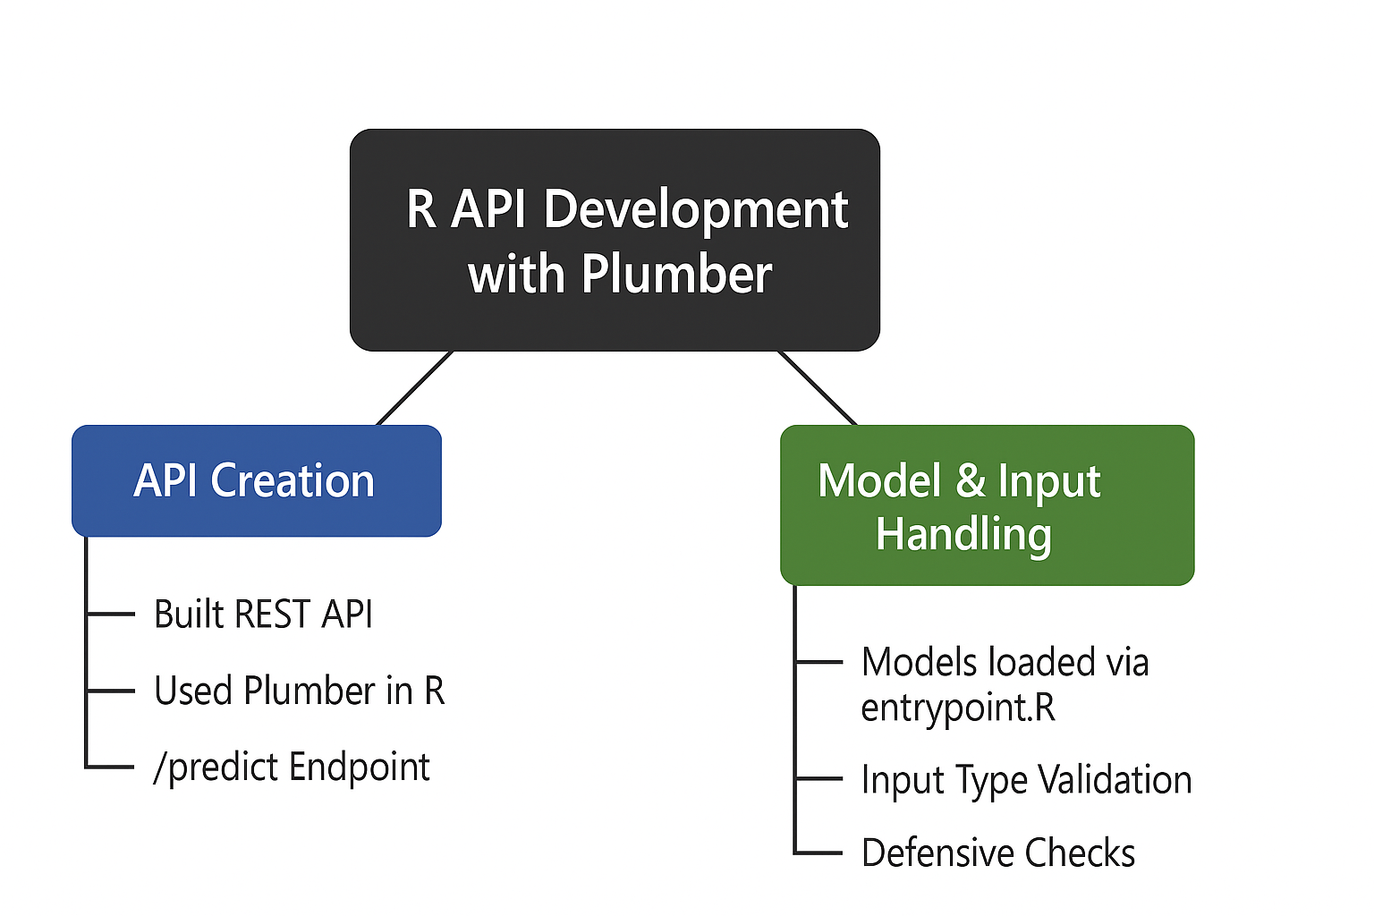
R API Development with Plumber
- Built REST API using Plumber
- /predict endpoint to serve predictions
- Models loaded in entrypoint.R
- Input handling and type validation
1
2
3
4

Slide 5
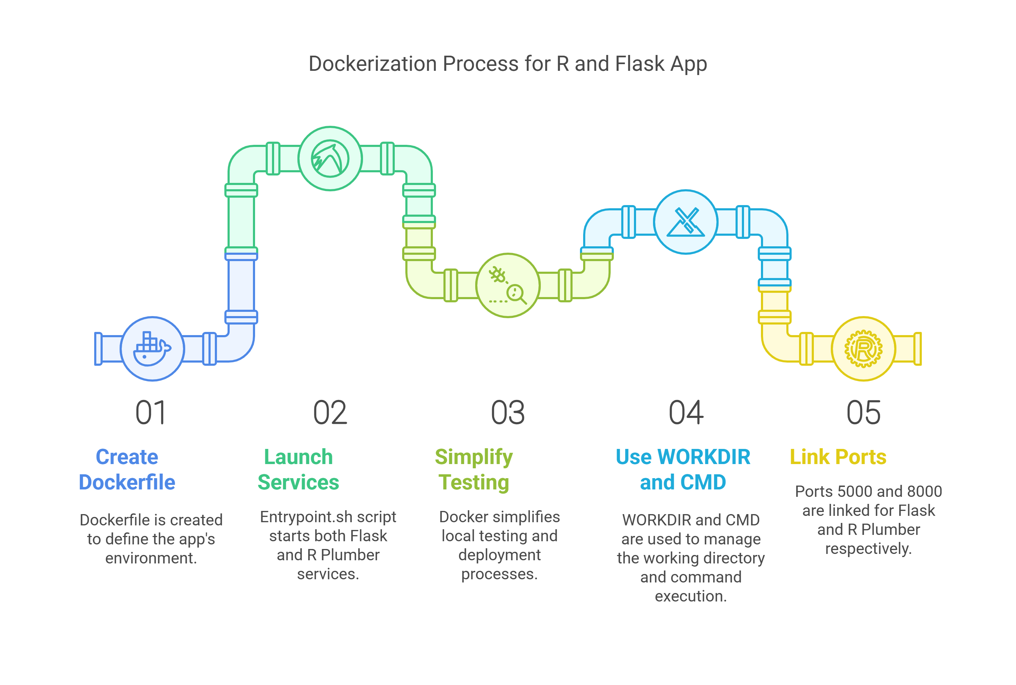
Docker-ization
-Created Docker file for combined R and Flask app
-entrypoint.sh launches both services
-Simplified local testing and deployment
-Used WORKDIR and CMD effectively
-Linked ports for Flask (5000) and R Plumber (8000)
2
3

Slide 6
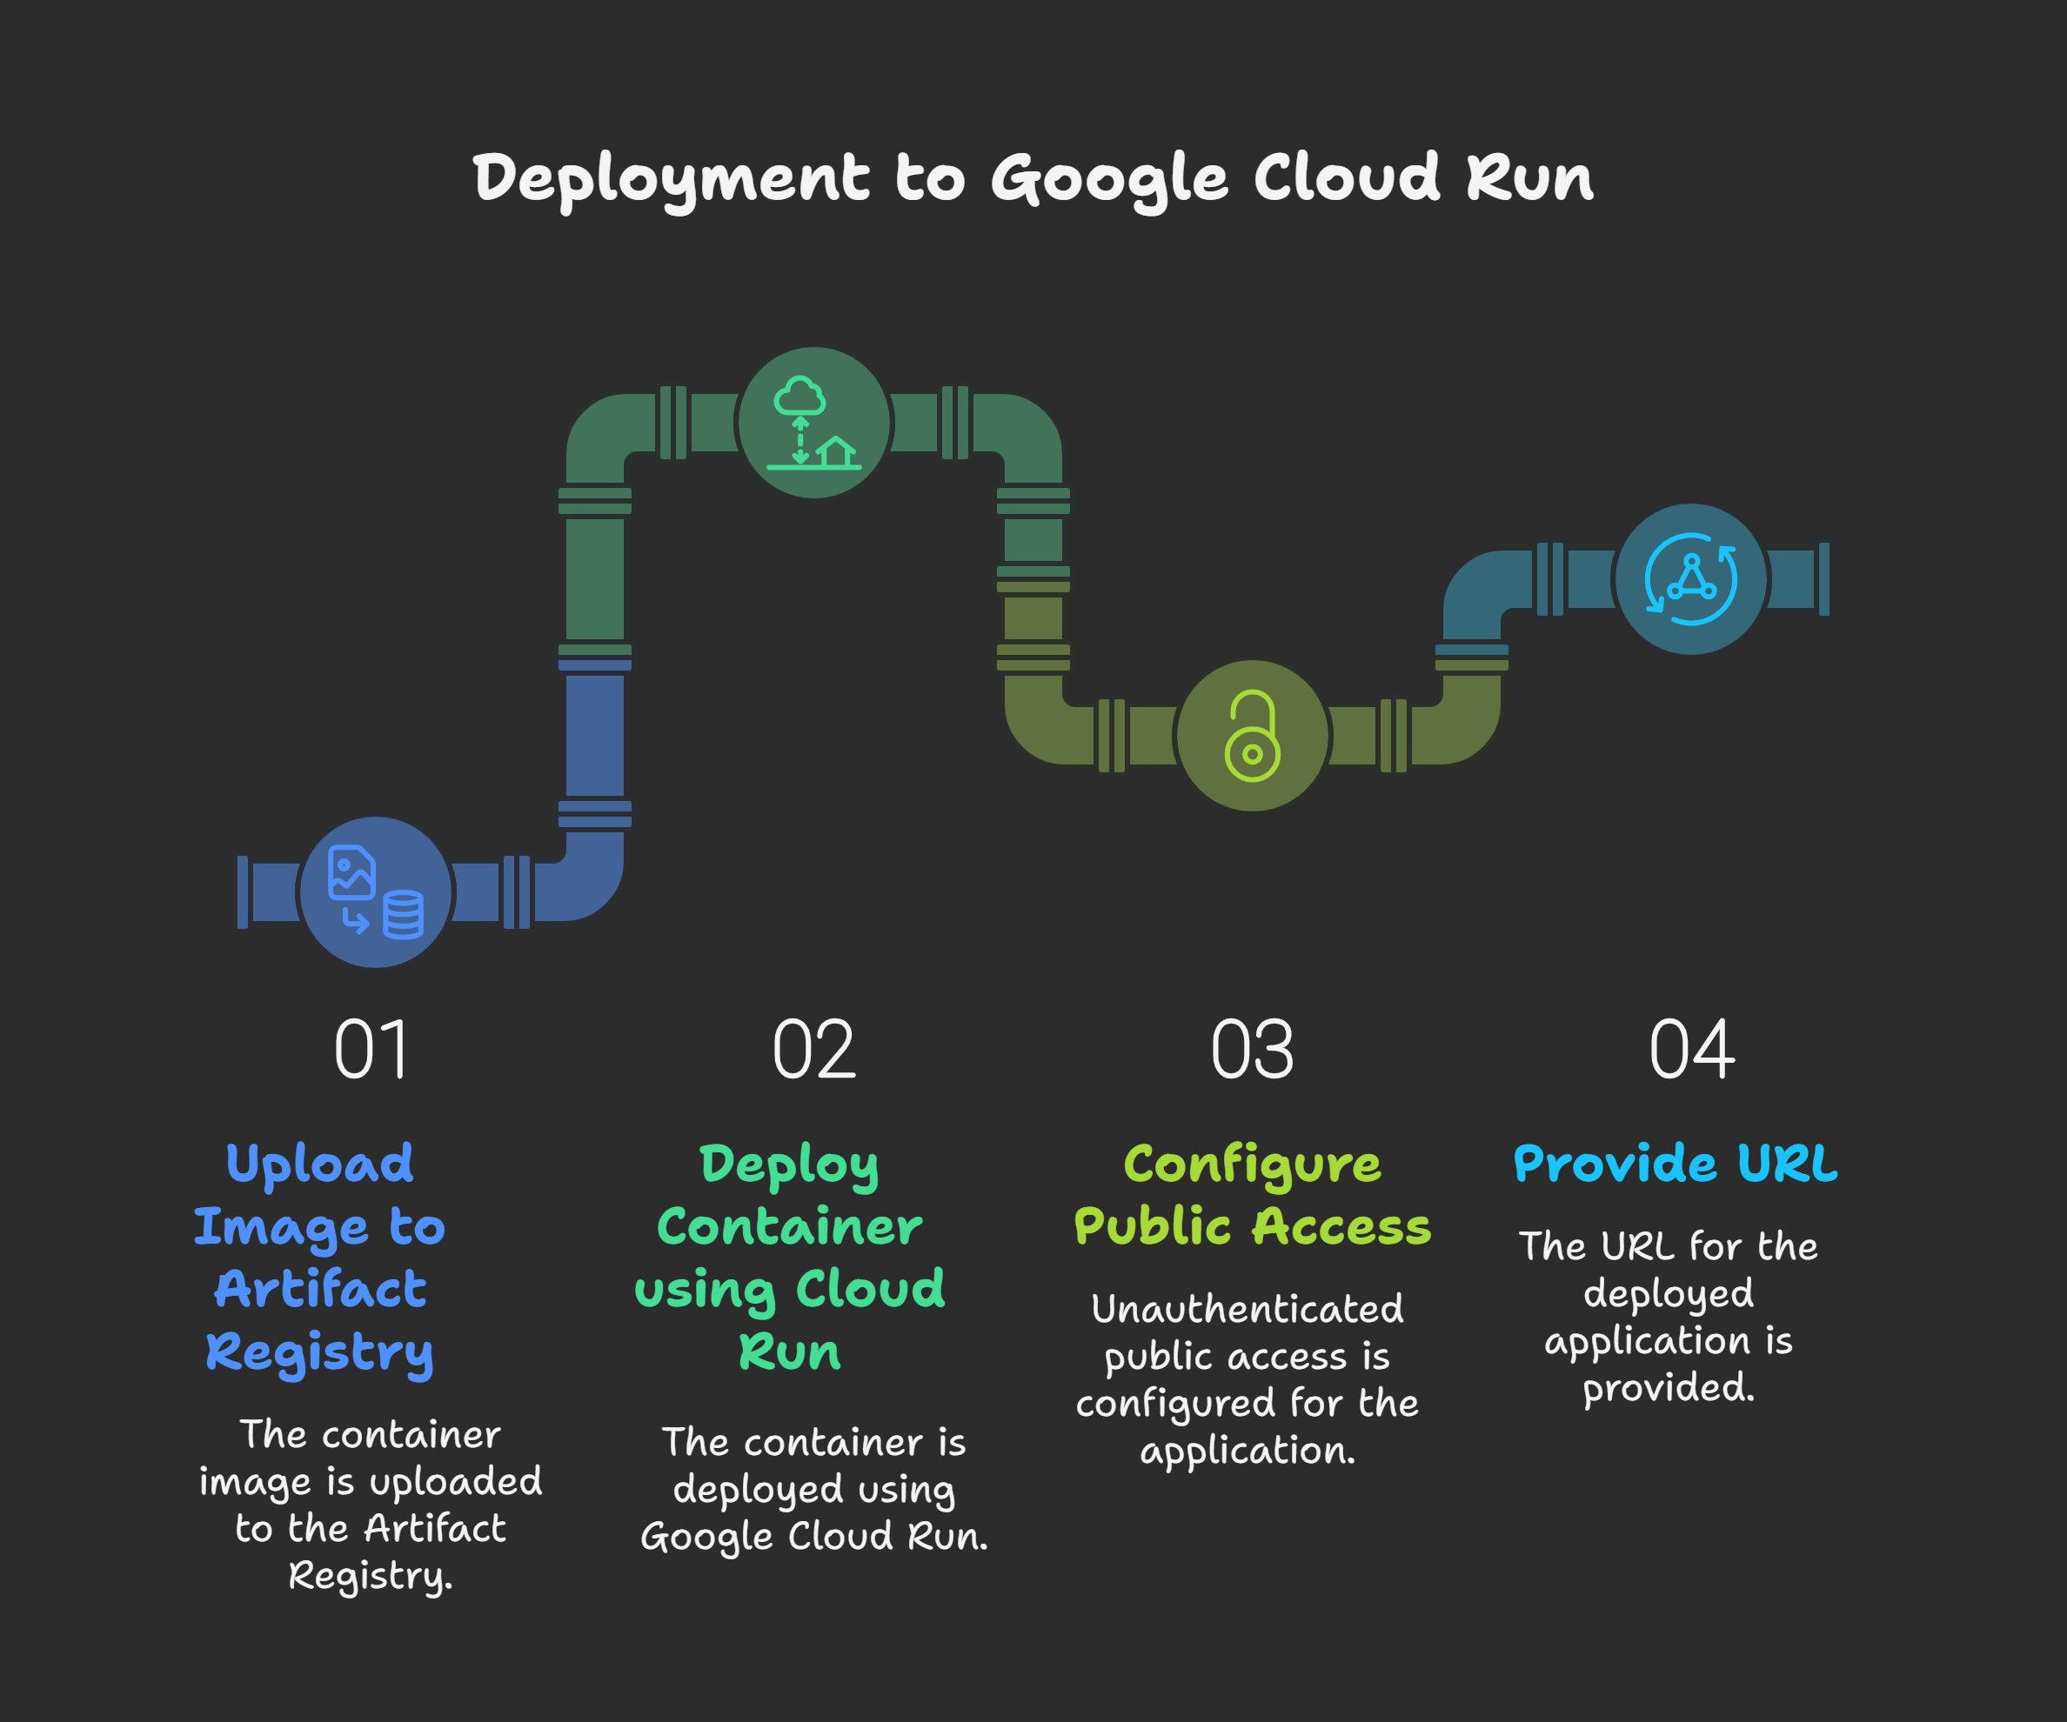
Deployment to Google Cloud Run
- Uploaded image to Artifact Registry
- Deployed container using Cloud Run
- Configured unauthenticated public access
- URL: https://heart-risk-app-802586937044.us-central1.run.app
1
2
3
4

Slide 7
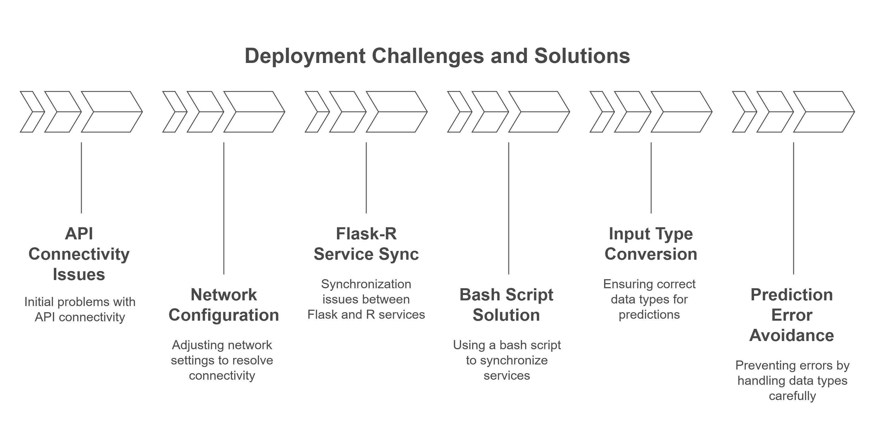
Challenges Faced and Solutions
1
2
3
4

Slide 8
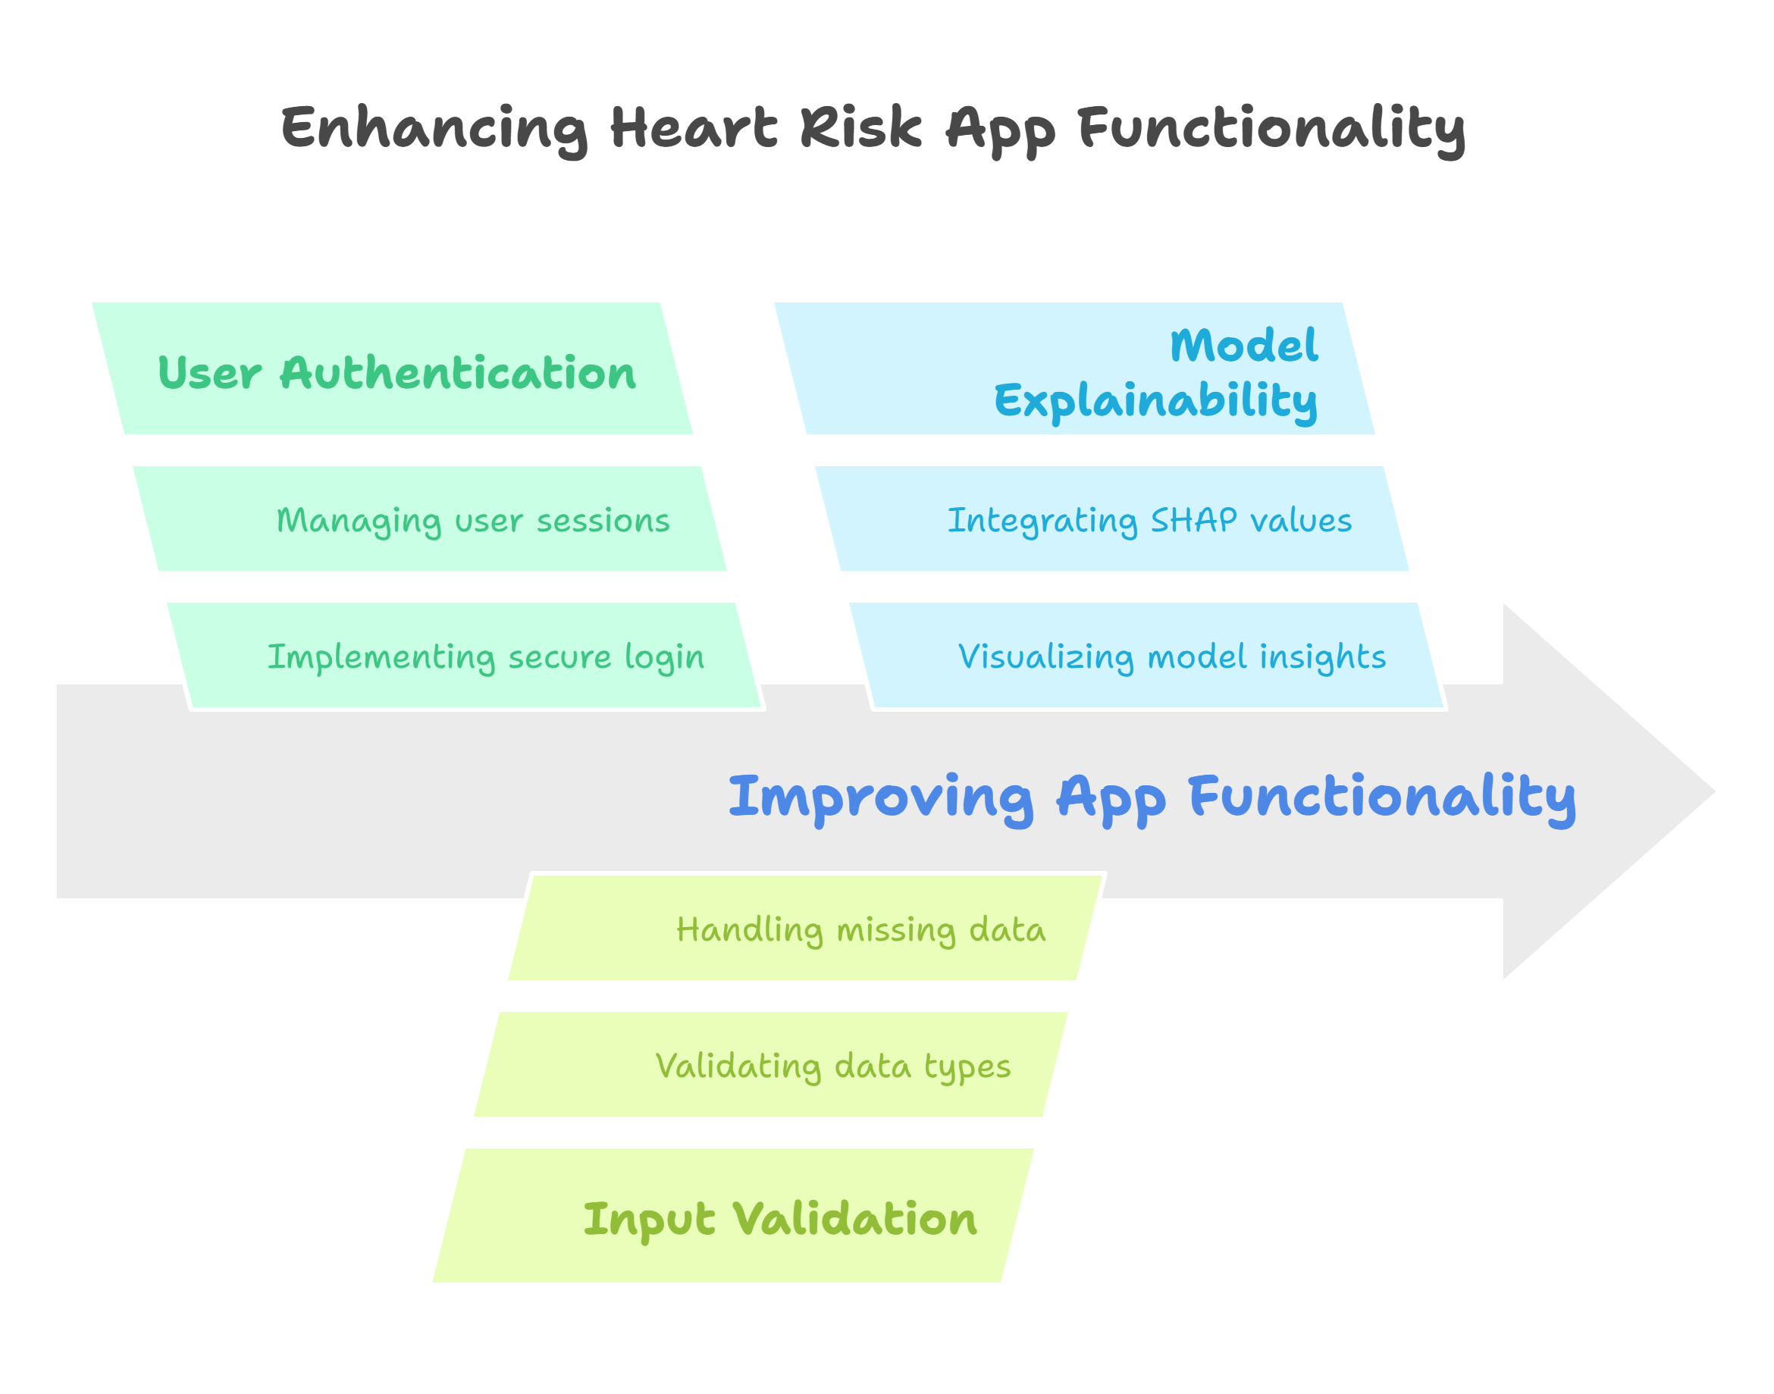
Future Improvements

Slide 9

Thank You!
Your time and attention are truly appreciated.
Feel free to ask any questions or give feedback.
Looking forward to your insights!
📧 Email: Ganta1u@cmich.edu 📞 Phone: (989) 621-3531

